Slide 1


Health Information System Strengthening:
Taking it to the next level in Uganda
Ministry of Health
Republic of Uganda

Slide 2

Health Information Systems:
Uganda’s Vision
The Health Sector has made great strides in strengthening HIS coordination and governance
  Despite this effort, challenges remain in coordination of data to facilitate comprehensive decision making
  Need to identify gaps and challenges within its HIS and develop a strategy for improvement to complement the other strategies like the eHealth strategy
Uganda is committed to applying and using globally developed and recommended assessment tools
As an important first step, we have conducted an assessment to describe the current stage of HIS and describe future goals

Slide 3
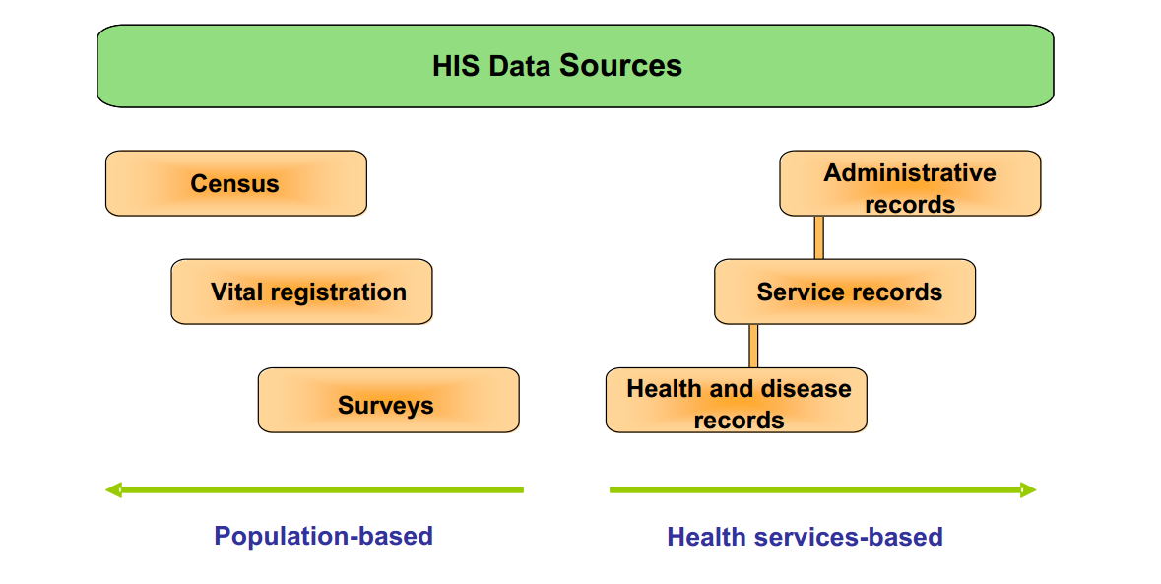
But What is HIS?
Health Information System: Is a system providing information support to decision making at all levels of the health system.
It incorporates information
generated by both population-based and institution-based data sources.

Slide 4
Objectives of the Assessment
To describe the current state of the HIS in Uganda at all levels
To establish a baseline and follow-up evaluation of the HIS that will be comparable over time.
To establish the key issues and challenges facing the HIS.
To use assessment findings to inform the development of an HIS strategic framework and mobilize resources for its implementation

Slide 5
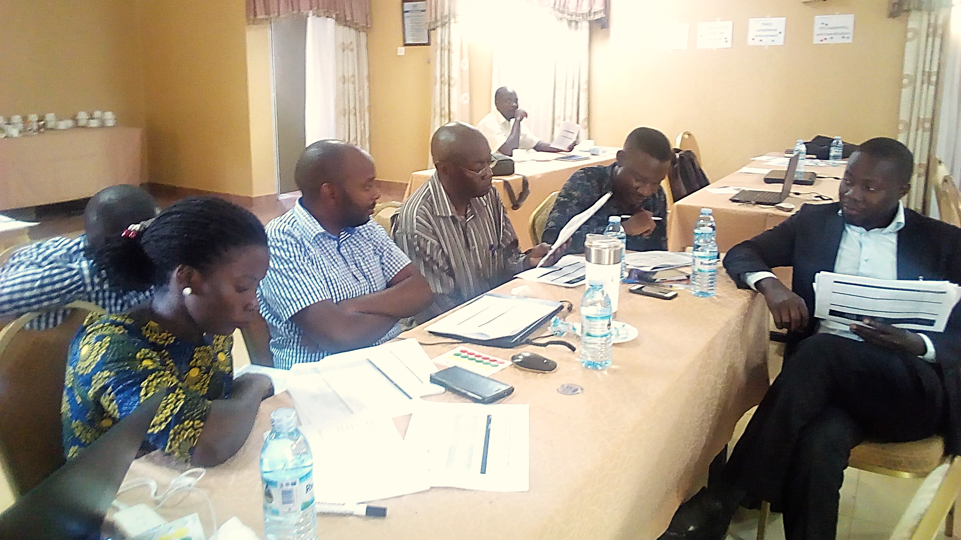
HIS assessment process
Key stakeholders from:
MoH (Planning, HR, DHI, all technical programs)
MOICT, NITAU, NIRA, UBOS
UNICEF, PEPFAR, CDC
Implementing partners, civil society, and academia
The assessment was implemented over a two day workshop:
  Day 1 focused on building consensus as to the current and goal status of 39 HIS subcomponents, mapped across the tool’s 5 domains
  Day 2 was dedicated to prioritizing gaps and corresponding actions resulting in an HIS improvement action plan with agreed upon actions, resources, and timelines

Slide 6
Assessment Methodology:
A stages of continuous improvement model:
Provides a means of describing stages through which systems can evolve to reach a predefined capability
Systematic method that is easy to understand and implement
“Stages,” or “levels,” refer to the progression towards given performance objectives
Stages have defined metrics that facilitate progression from one stage to another as a way to characterize improvement
Notes:
Notes
Before get too involved in the stages of continuous improvement, let’s make sure we all understand what we mean by stages and why we have chosen this approach.
A Stages model is a specific type of model or approach that was developed in the business and IT industry and was initially use for quality improvements, often in manufacturing. The first one was developed in the late 1970s and was a quality management grid meant to improve service and product quality. It had four stages, with clearly defined attributes for each stage.
A stages model, also called maturity model, offers a relatively simple way of describing the progression towards higher capabilities in terms of process, people, technology and organizational capabilities. Each stages has pre-defined metrics across multiple domains and components that characterize progression across different stages. For instance, let’s look at the leadership and governance domain. This domain can include HIS strategy and policy as a component of that domain. The attributes of this component (the HIS strategy) will characterize (or describe) improvements as you move toward higher stages. We will learn more about domains and components in the later part of this course.

Slide 7
What is the value added by a stages model?
Offers a holistic model that demonstrates the interplay of HIS components
Strengthens empirical validation and measurement indicators
Provides guidance on how to overcome gaps identified in HIS components
Specific to low resource settings
Notes:
One question you can ask is what value the stages model offers when we already have several assessment tools. As you might know the Health Metrics Network of the WHO, USAID, ITU-WHO and USAID-MEASURE Evaluation project have described key dimensions or domains of an HIS.
However, assessments tools are primarily focused on individual domains like data quality, data use, interoperability, etc. and lack an overall assessment of HIS with clearly described attributes of progression. Even though there are several maturity models, there was lack of an appropriate stages model in the context of lower and middle income countries. To fill this gap, this tool uses a measurement scale with clearly defined indicators at each stage. Furthermore, it offers guidance about what to do once gaps are identified. Meaning development of the improvement roadmap.

Slide 8
Results: Aggregated individual scores
Notes:
This graph shows the individual scores for each of the 13 sub-components. We are not presenting the details of the individual scores here since the final output was determined in the group conversation that built on the individual inputs. However, we are presenting the individual scores to explain the synergy between individual and group scores.

Slide 9
Results: Group scores
Notes:
As you can see that individual aggregated scores and group scores are very close which highlights common understanding among the stakeholders. This graphic shows the actual and future goal for various components of HIS that stakeholders finally agreed. This information was used to prioritize and draft improvement plan. The stakeholders prioritized HIS leadership and coordination, HIS Strategic Planning, HIS competencies, data management, and MFL in the workshop. Other areas also needs improvement plan and we will work on it together with all of you.

Slide 10
Critical action points
Data gathered from the SoCI assessment illuminates progress, gaps and a future roadmap in Uganda’s ability to:
  Strengthen data exchange, in alignment with Interoperability Assessment findings
  Develop a master facility registry
  Build HIS competencies of health workforce
  Enhance HIS leadership and coordination capacity
  Improve data use for decision making.

Slide 11
What next?
The results have been presented to HIS TWG
The MFL has been signed off, and the roadmap is being developed to move it to a registry
HIS strategy-to improve governance, leadership and the whole data management cycle will be developed basing on the HIS assessment results.

Slide 12
What next?
Indicator manual (all program indicators) coming out soon
Hope to carry out an HIS training needs assessment

Slide 13
Our experience
The tool was easy to use and gave a quick overview of our current status and suggested quick solutions which we as a country need to think about in driving the next agenda.
Application of the SoCI assessment in Uganda:
  helped to review progress of institutional capacity for analysis and learning
  synthesized information around HIS progress and goals to guide strategic planning and HIS investments.

Slide 14
Our experience cont.
  We hope to be assessing ourselves with the tool every 2 years (some people were excited and wanted to do it every six months)
  Communication and involvement to all stakeholders is important for ownership and resource mobilization
  Pay attention to the details!

Slide 15
Appreciation
This tool was developed collaboratively by:
The Health Data Collaborative Digital Health and Interoperability Working Group,
CDC and the USAID-funded MEASURE Evaluation
Ministry of Health leadership

